Slide 1

What’s New at National Women’s?
Andrew Johnson March 2024

Slide 2
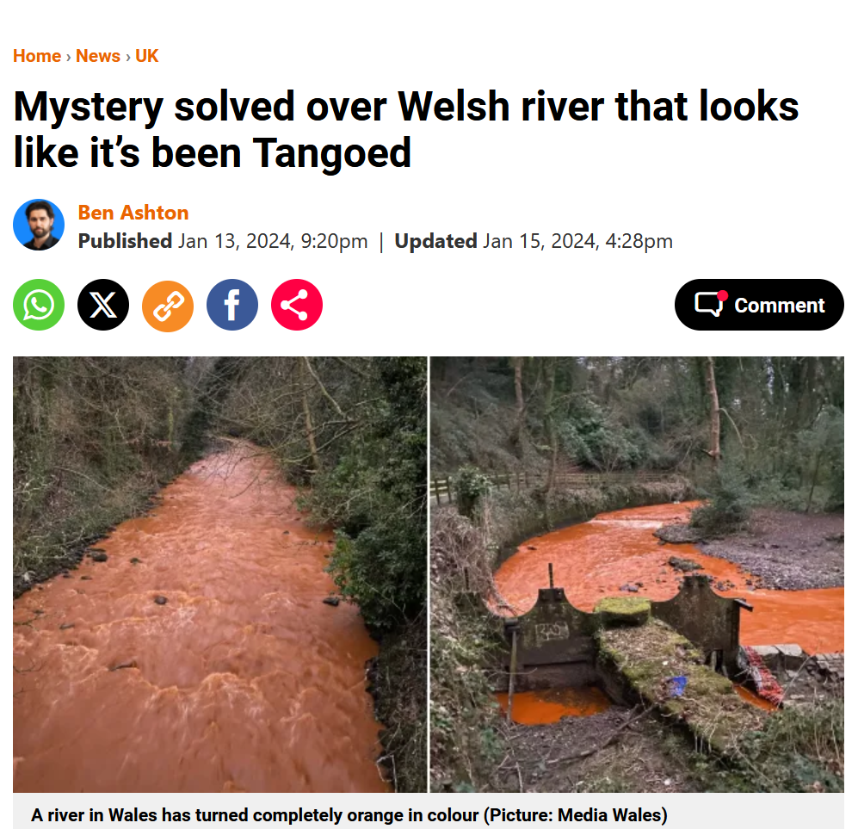

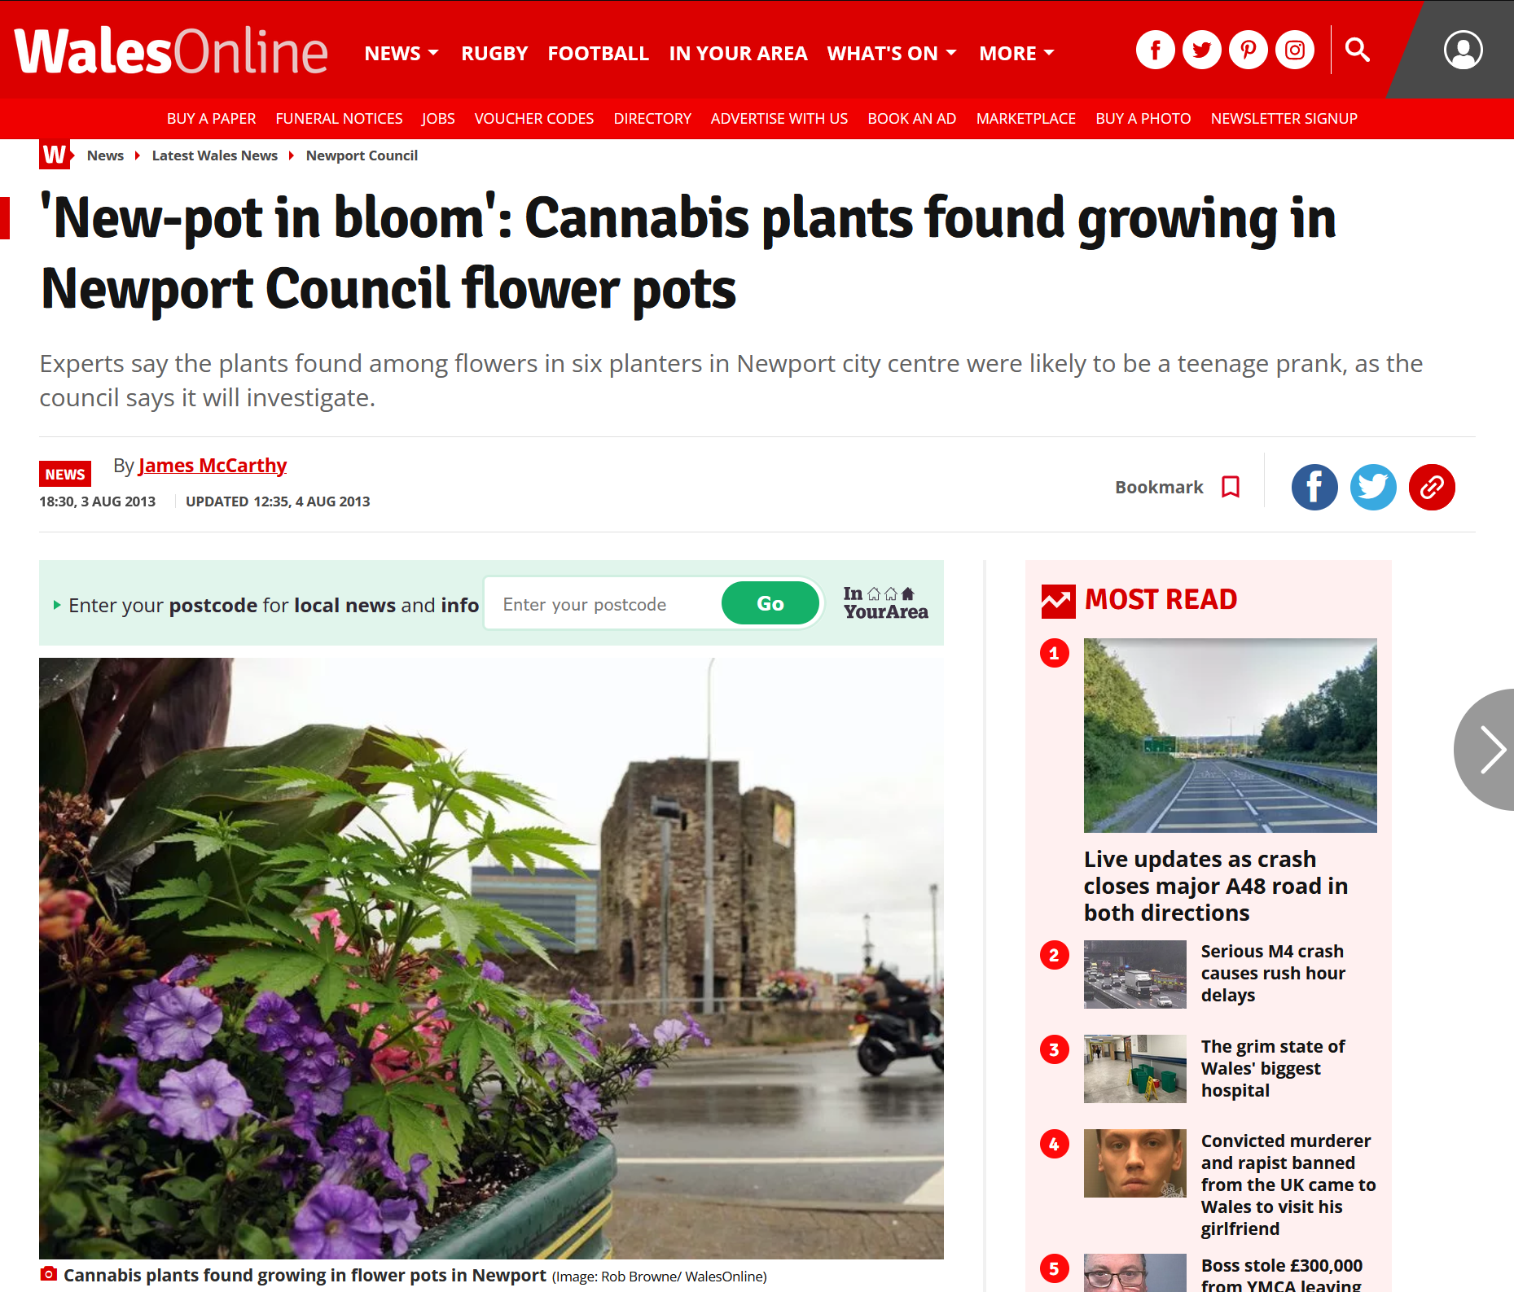
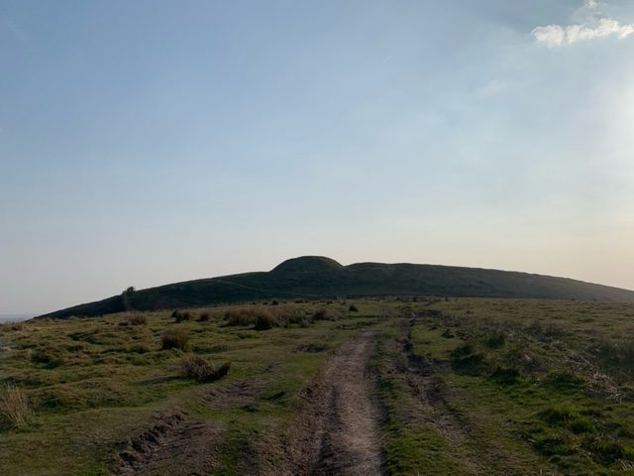
Pepeha

Slide 3
1. Digital anaesthetic recordkeeping system for the delivery suite
2. Post Dural Puncture Headache Pathway Document
3. Placenta Accreta MDT
4. Women’s Health Emergency Manual
5. End of List Debrief
Topics

Slide 4
Digital Anaesthetic
Record

Slide 5
SAFERsleep® Maternity Module
SAFERsleep OR across Auckland theatres several hospitals across NZ private and public
Delivery Suite / ‘off the floor’ record keeping
Current Practice

Slide 6
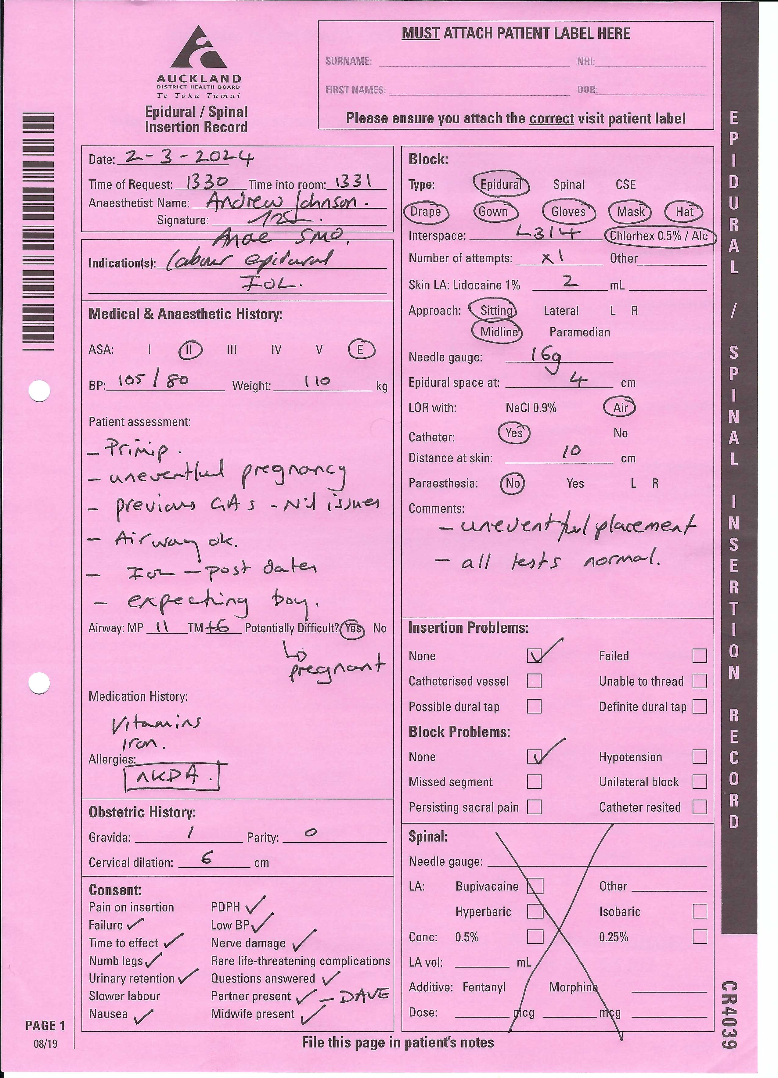

Slide 7
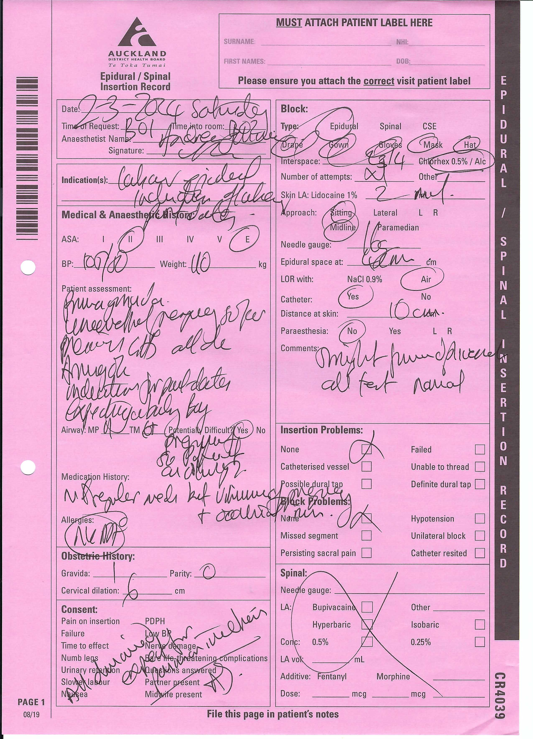

Slide 8
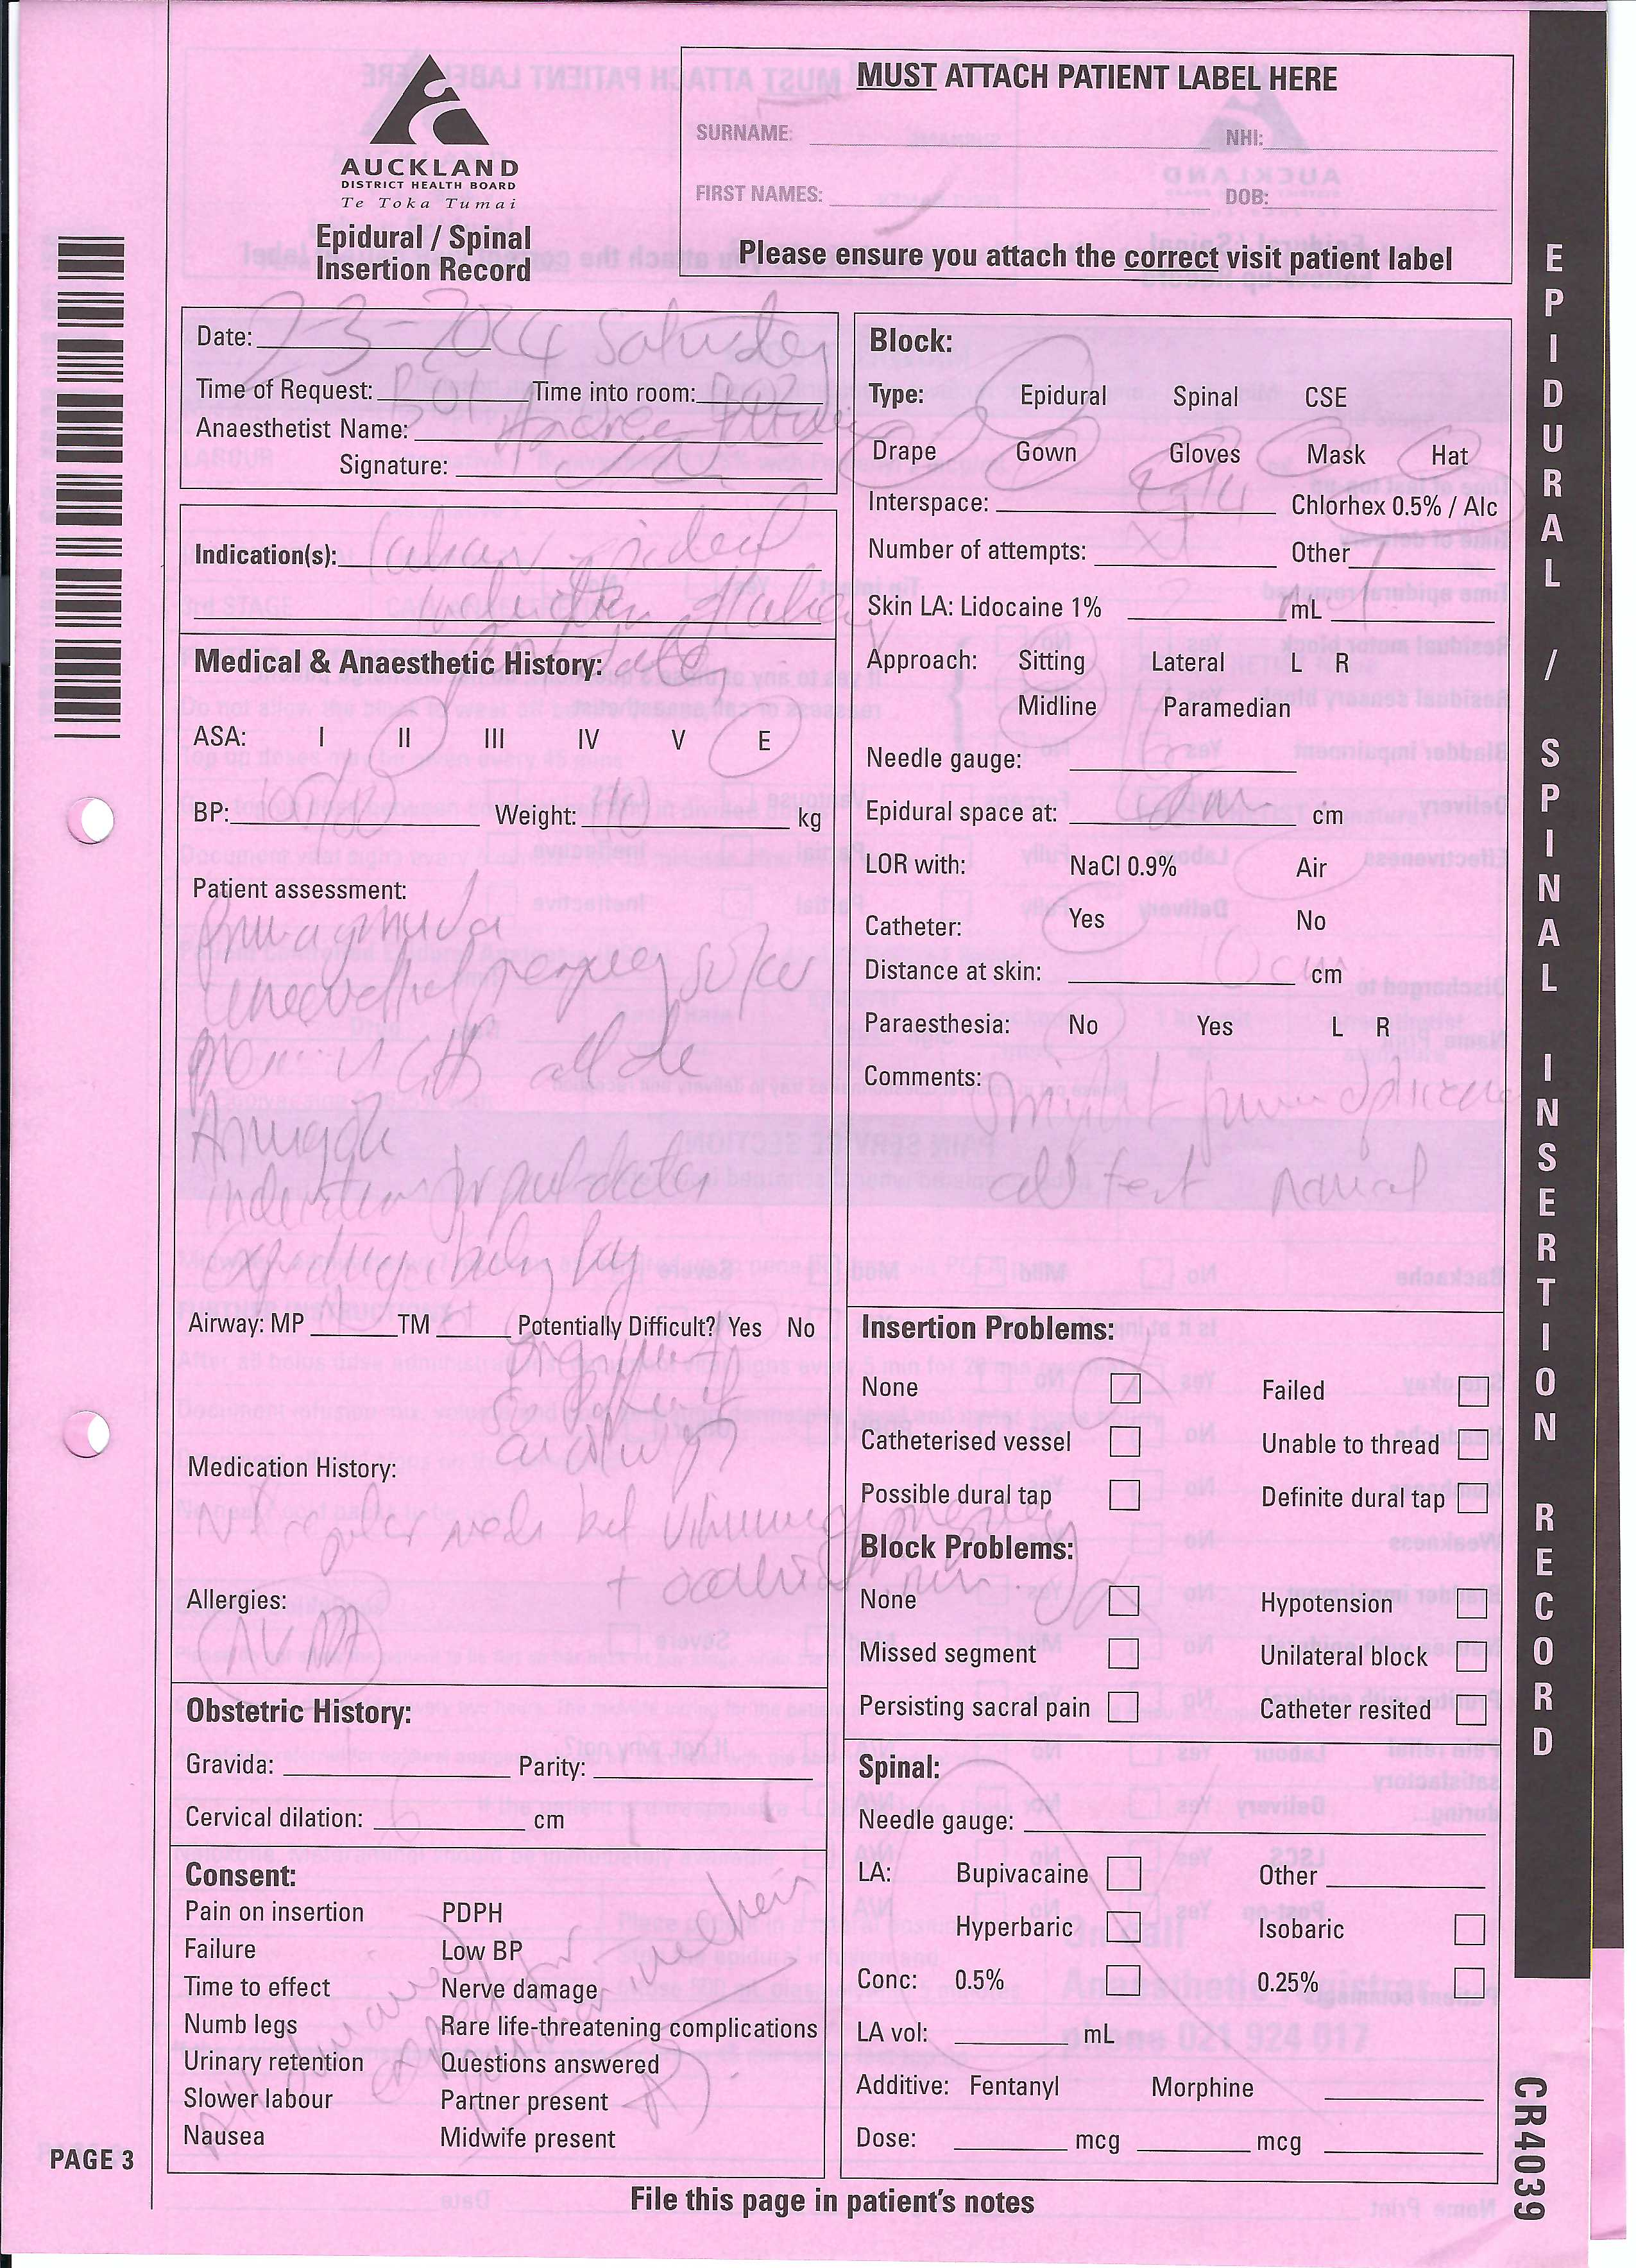

Slide 9
SAFERsleep® Maternity Module
Conception
  Dec 2018 proposed ‘plan A’ = Use SAFERsleep OR
Advantages:
  Already in place, minimal cost, no user learner curve
Disadvantages:
  Not bespoke, future changes would have to impact all SAFERsleep OR package, not all ‘pink form’ issues were covered.
BADGERNET incoming!

Slide 10


SAFERsleep® Maternity Module
BADGERNET incoming!
  (Ultimately will be a National Maternity service)
Time pressure, plan ‘b’ design a bespoke module that would fit our needs … 3years pregnancy
Uncomplicated delivery of SAFERsleep Maternity Module Beta 1 April 2022 (just after Badgernet)
SAFERsleep Maternity Module v8.0.596

Slide 12
Uniformity
  Instantly Recognisable form
  Matches our SS.OR Print outs
  Red vertical Stripe
Unique identifier
  Bar Code and CR coding number
  Easily searchable for audit/ review
Improved safety
  Easily readable
  Sections pre-populated – improved compliance with form filling
  Allergy section
  Instantly uploaded to RCP – patient hospital record
All aspects of previous form matching and in corresponding places

Slide 13
Uniformity
  Instantly Recognisable form
  Matches our SS.OR Print outs
  Yellow Stripe for Local Anaesthetic Prescription
Improved safety
  Easily readable
  Sections pre-populated – improved compliance with form filling
  Local Anaesthetic Toxicity calculation
All aspects of previous form matching and in corresponding places

Slide 16
SAFERsleep® Maternity Module
Work Flow:
  Epidural request
  Tablet into delivery suite room
  Check patient details and login
  Discussion and completion of procedure
  SAFERsleep input and print form
  Collect print out
  Return with signed print out and Ice to check block

Slide 17
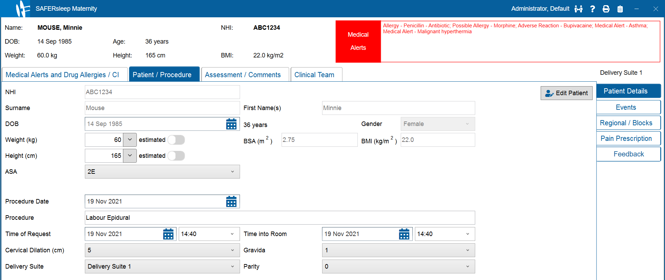
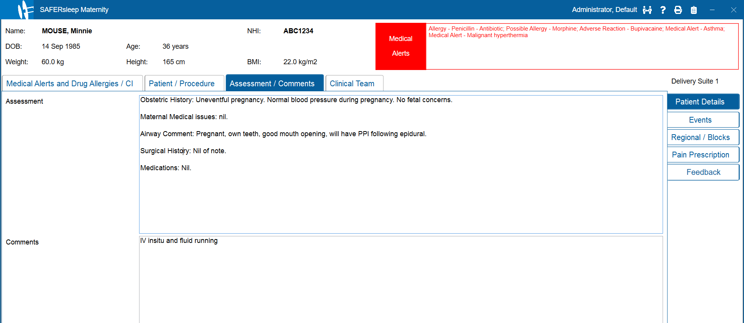
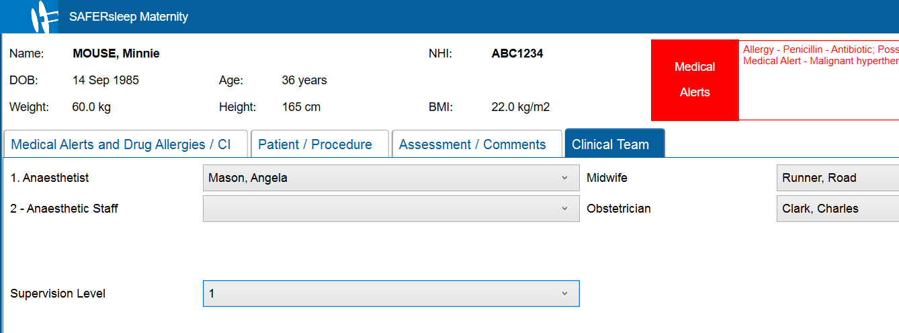
SAFERsleep® Maternity Module
  Interface

Slide 18
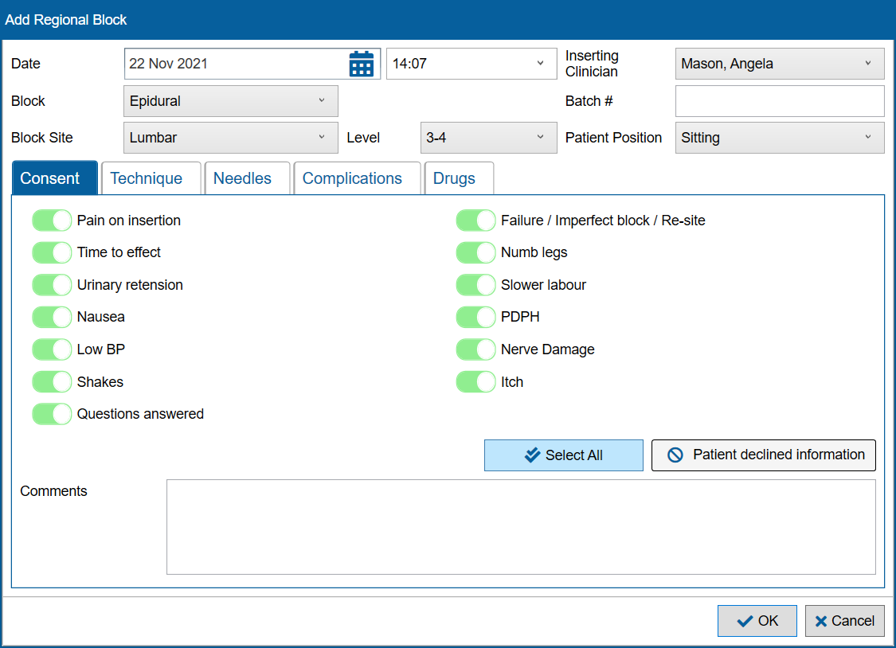
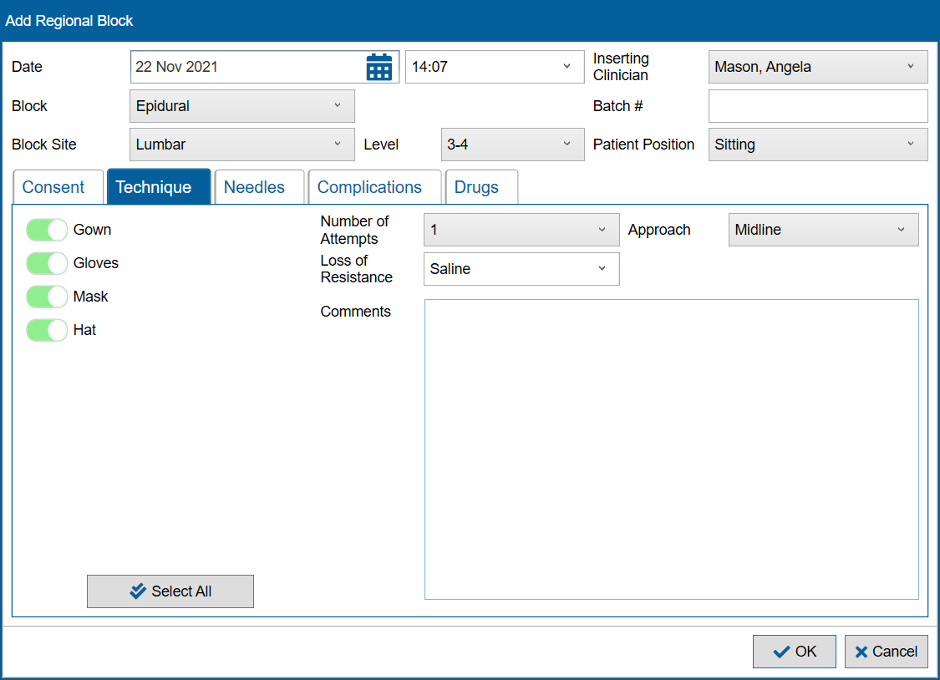
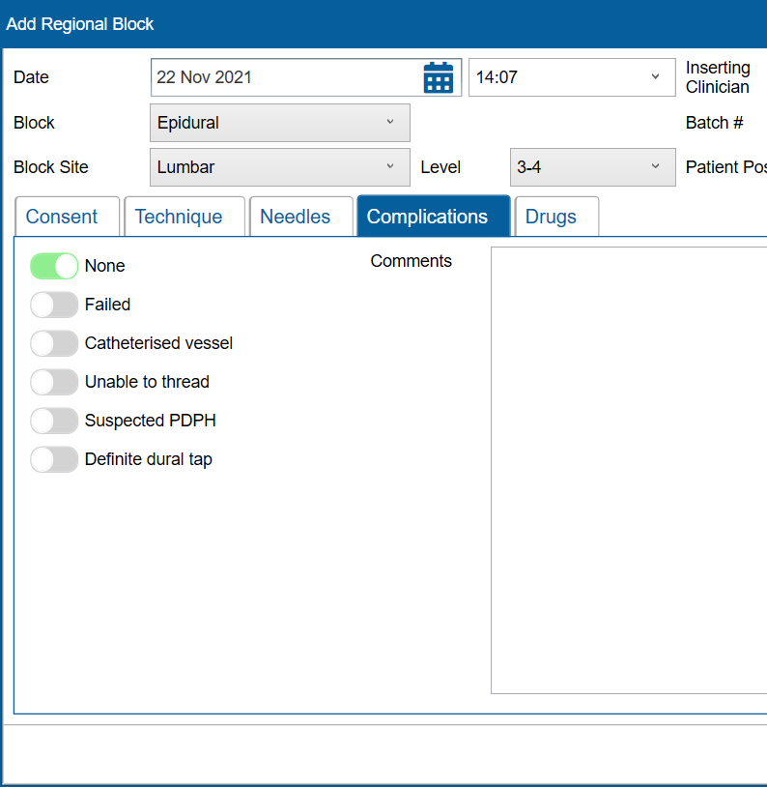
SAFERsleep® Maternity Module

Slide 19
SAFERsleep® Maternity Module
Bonus Material
  Flow through of information to SS.OR and SS Pain modules
  Remifentanil PCA Prescription & Guideline
  Customisable templates
  Post Dural Puncture Headache Pathway
  Intrathecal catheter placement
  Each printout also includes a letter to the woman with what to watch out for

Slide 20
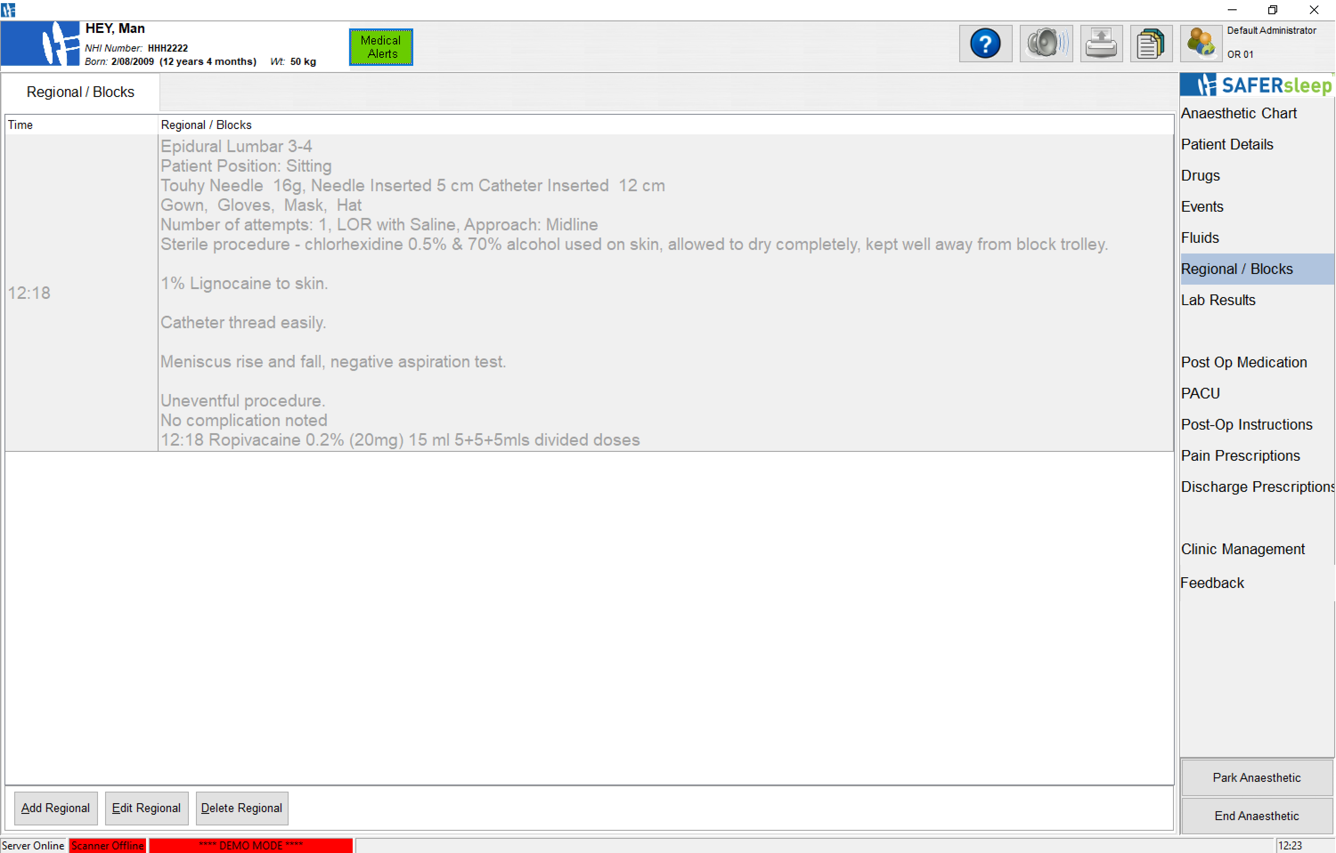
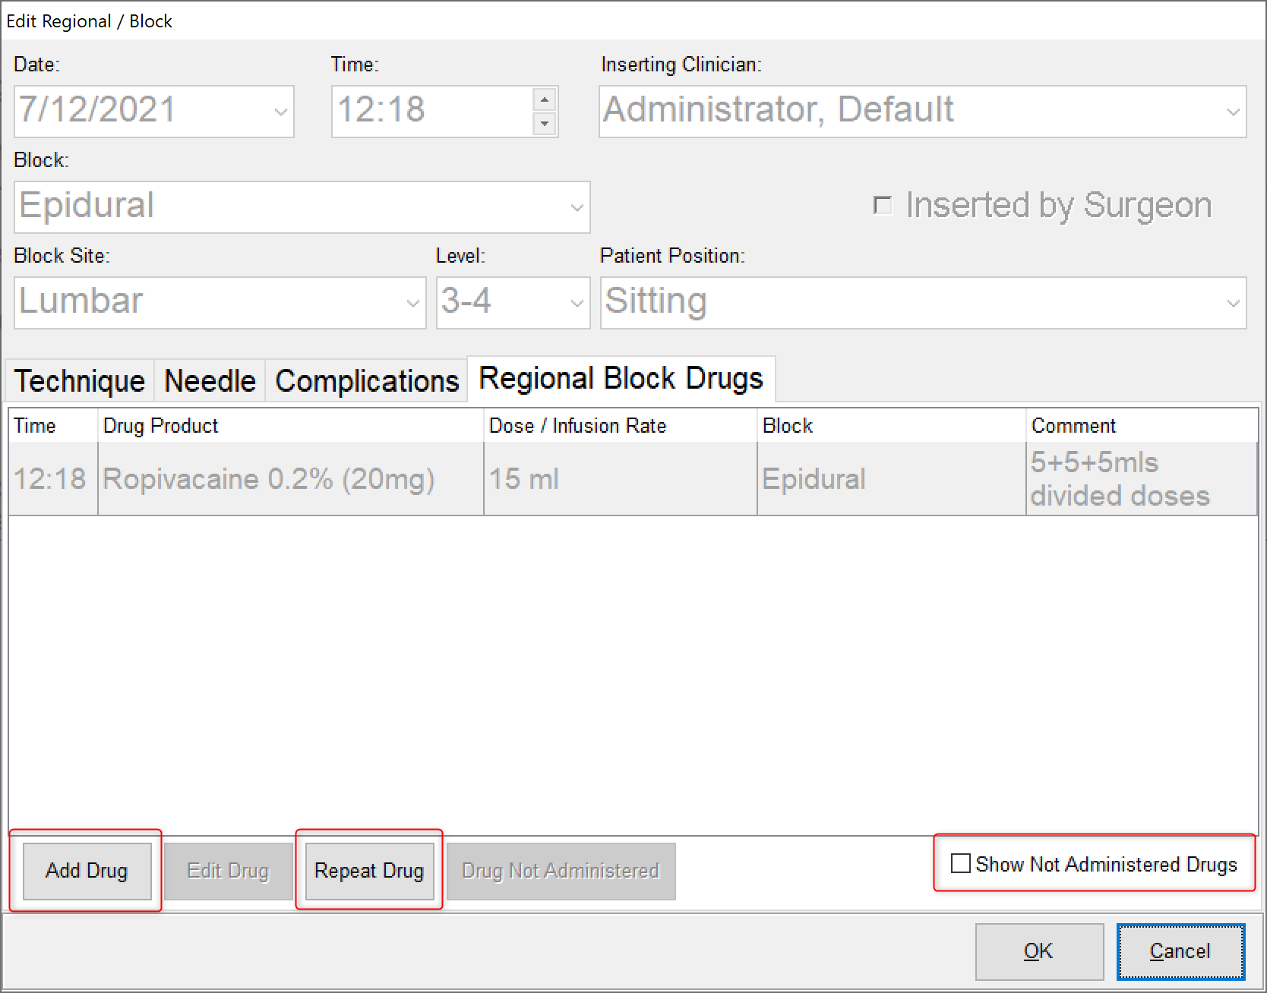
SAFERsleep® Maternity Module
Flow through of information to SS.OR and pain modules

Slide 21
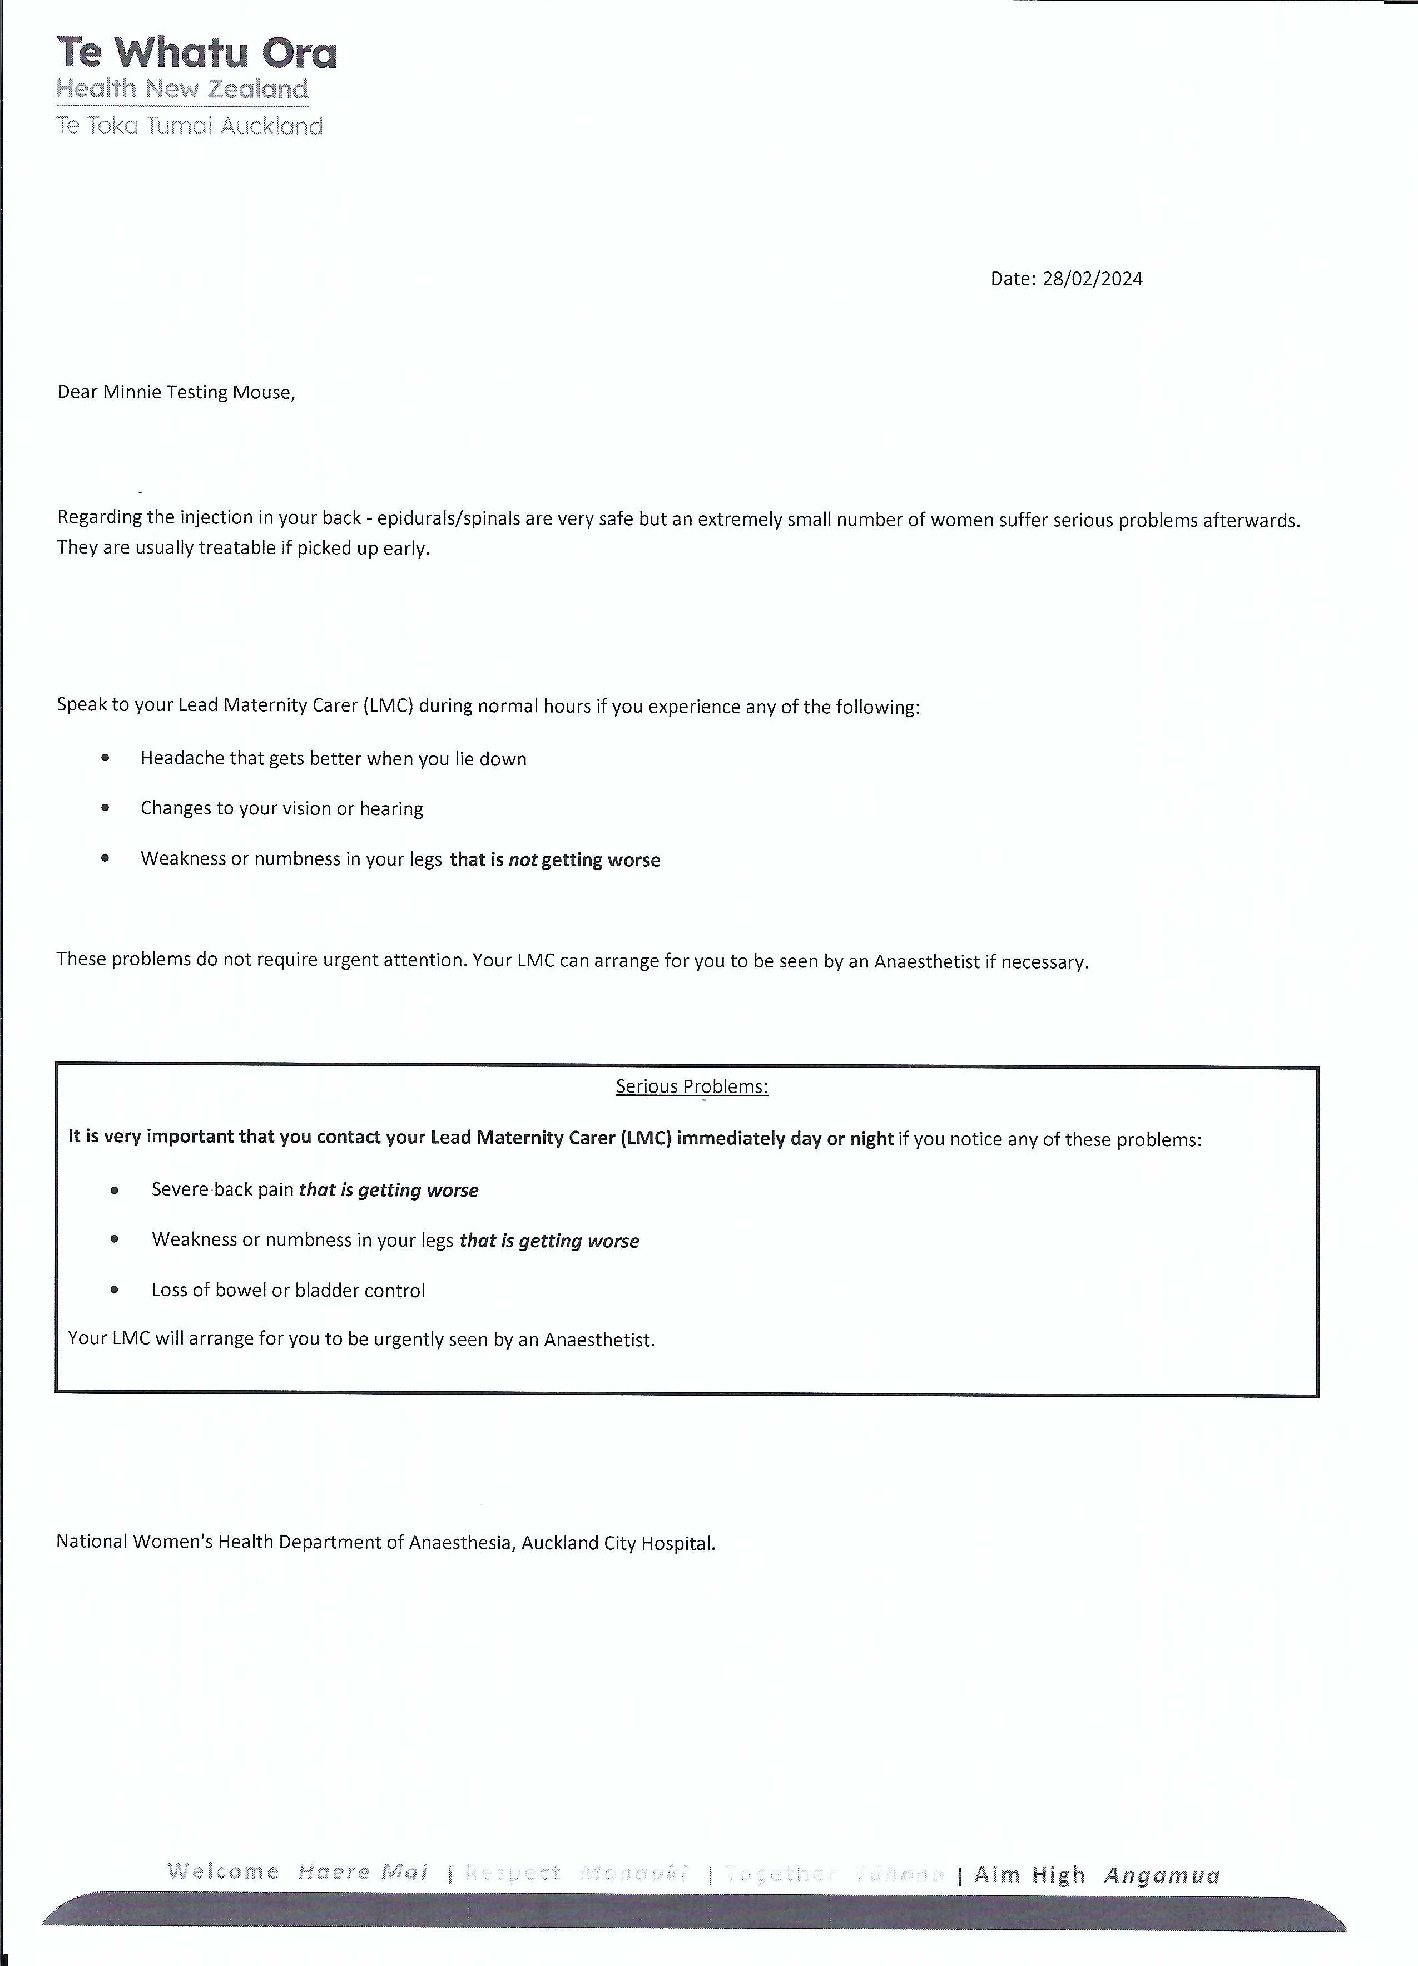

Slide 22
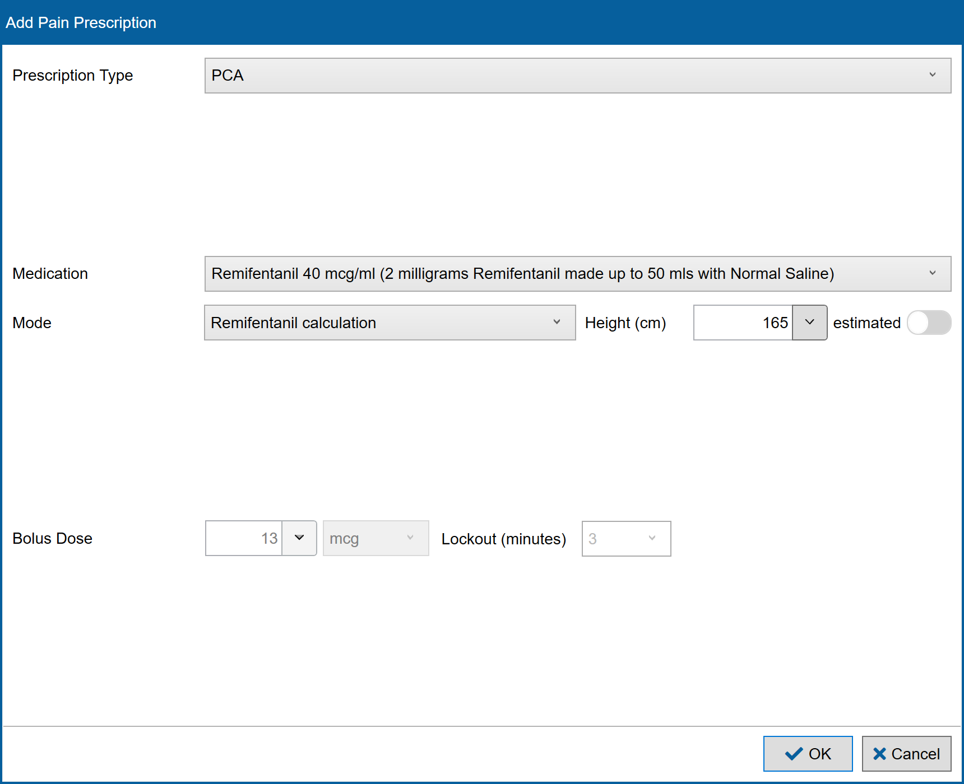
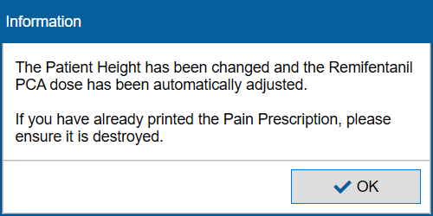
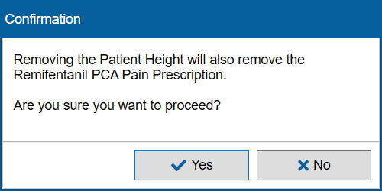
SAFERsleep® Maternity Module
Remi PCA unique to Delivery Suite with safety features & cut outs…

Slide 23
SAFERsleep® Maternity Module
Data Collection
  KPI – Time from request to arrival
  Accurate number of ‘off the floor’ epidurals/ procedures
  Links to SAFERsleep Pain module numbers being followed up/ college standard
  Complications – very easy to drill through
  Centralised, backed-up, out of office

Slide 24
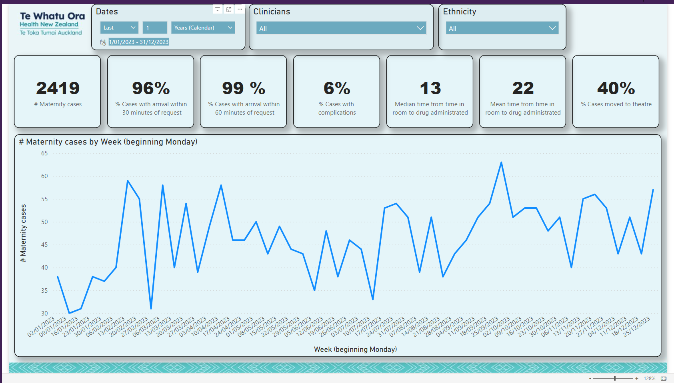

Slide 25
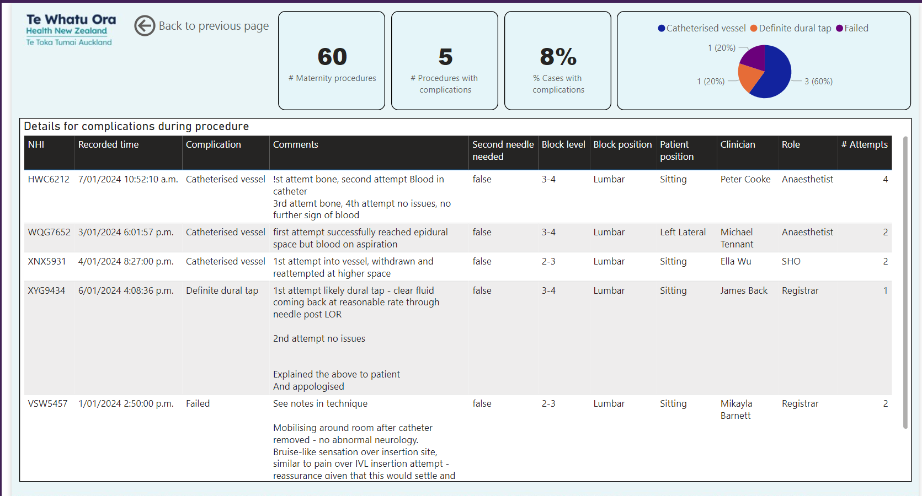

Slide 26
SAFERsleep® Maternity Module
My thoughts
  Difficult introducing anything new!
  Outline clear goals early on
  Grateful interface is the same as a current product
  Health New Zealand - ?Easily reproduceable at other sites
  Still potential for missing / incorrectly filled in data
  Cost incurred – hopefully if others adopt base product is already produced
  Reduce Clinical Prescribing errors, automated checks/ legibility issues
  Clinical decision support – real time alerts, reminders, guidelines
  ?more efficient work flow – ie more time with patient in DU room, Cat 1 info can be pulled through
  Space saving – less stacks of paper around/ environmental benefits aim – paperless?
Notes:
My thoughts
Difficult introducing anything new!
Outline clear goals early on – makes it an easy sell of final product to colleagues, correspondence with developer is with a non medical, non computer programmer – considered language and explanation
Grateful that it looks similar to the prior product, and the user interface is the same as a current product.
Health New Zealand - ?Easily reproduceable at other sites
Still potential for missing / incorrectly filled in data
Cost incurred – hopefully if others adopt base product is already produced
Reduce Clinical Prescribing errors, automated checks/ legibility issues
Clinical decision support – real time alerts, reminders, guidelines
?more efficient work flow – ie more time with patient in DU room, Cat 1 info can be pulled through
Space saving – less stacks of paper around/ environmental benefits aim – paperless?

Slide 27
Post Dural Puncture Headache Pathway

Slide 28
PDPH Pathway Trigger
A complaint from patient and family regards her care relating to the insertion of her epidural and the time it took for a clear plan to be made regards her management.
Labour Epidural sited 2018.
Multiple attempts – 7 total between RMO and SMO
Day 1 post VD – postural headache ?Dural tap. All treatment options discussed with anaesthetist.
Plan = patient to decide if she wanted EBP.
No booking for EBP made
Later - confusion in clinical notes "re: patch or not?" …pain was now documented as head and neck pain and the thought moved away from post dural headache and towards a musculoskeletal pain.
Therefore EBP taken off cards but not communicated to patient.
Further delays occurred due to poor communication with pain service, acute anaesthetists and LMC - the consequence of which a further 4 days and multiple reviews from various specialties a CT head before returning to the original diagnosis: PDPH and a EBP was performed with good effect.
Notes:
Brief Case details re trigger for current PDH forms.
A complaint was received from patient and family regards her care in the hospital. This related to the insertion of her epidural and the time it took for a clear plan to be made regards her management. Like all complaints there were multiple issues involved.
Epidural sited in 2018.
There were multiple attempts at an epidural totaling 7 between the RMO and SMO.
1. The patient was reviewed the day following her delivery. She had a headache thought to be due to a Dural tap and discussed all the treatment options with the anaesthetist.
the plan was for the patient to decide if she wanted a patch.
o No booking for a blood patch was done.
2. later that day there was a confusion in the notes "confused re: patch or not." the pain was now documented as neck pain and the thought moved away from post dural headache and towards a musculoskeletal pain.
3. There was no communication to patient that her blood patch procedure had been cancelled
4. There was a lack of communication within the pain and on call teams regarding her management - the consequence of which being that it would be a further 4 days and multiple reviews from various specialties before they returned to the original diagnosis and a patch was performed with good effect.
5. Day 4 a CT scan was performed looking for a cause of the headache.
Patient was overwhelmed by the information that was given to her regarding the management of PDPH.
The basis for reviewing the form was
1) There was no single point of documentation regards her management
2) There was nothing to indicate to ward staff that the patient was on a PDPH pathway.
3) “The Anaesthetic Department is developing a new PDPH follow-up form. The concept now is a follow up form that has more detail in it for every entry and more importantly, it will form a document within the patient’s notes that will indicate that she is on the PDPH pathway “

Slide 29
PDPH Pathway Trigger
The basis for reviewing the process:
  There was no single point of documentation regards her management
  There was nothing to indicate to staff that the patient was on a PDPH pathway.
  Streamline information given to patient and family
Notes:
Brief Case details re trigger for current PDH forms.
A complaint was received from patient and family regards her care in the hospital. This related to the insertion of her epidural and the time it took for a clear plan to be made regards her management. Like all complaints there were multiple issues involved.
Epidural sited in 2018.
There were multiple attempts at an epidural totaling 7 between the RMO and SMO.
1. The patient was reviewed the day following her delivery. She had a headache thought to be due to a Dural tap and discussed all the treatment options with the anaesthetist.
the plan was for the patient to decide if she wanted a patch.
o No booking for a blood patch was done.
2. later that day there was a confusion in the notes "confused re: patch or not." the pain was now documented as neck pain and the thought moved away from post dural headache and towards a musculoskeletal pain.
3. There was no communication to patient that her blood patch procedure had been cancelled
4. There was a lack of communication within the pain and on call teams regarding her management - the consequence of which being that it would be a further 4 days and multiple reviews from various specialties before they returned to the original diagnosis and a patch was performed with good effect.
5. Day 4 a CT scan was performed looking for a cause of the headache.
Patient was overwhelmed by the information that was given to her regarding the management of PDPH.
The basis for reviewing the form was
1) There was no single point of documentation regards her management
2) There was nothing to indicate to ward staff that the patient was on a PDPH pathway.
3) “The Anaesthetic Department is developing a new PDPH follow-up form. The concept now is a follow up form that has more detail in it for every entry and more importantly, it will form a document within the patient’s notes that will indicate that she is on the PDPH pathway “

Slide 30
PDPH Pathway
Born Autumn 2019, now version v.1.7
Integrates with Maternity Module
  “Suspected dural puncture or wet tap” at time of labour epidural
Databank running in background which will allow for improved auditing
Increased Pain Nurse FTE to allow for follow ups

Slide 31
Uniformity
  Instantly Recognisable form
  Matches our SS.OR Print outs
  Red vertical Stripe
Unique identifier
  Bar Code and CR coding number
  Easily searchable for audit/ review
Improved safety
  Easily readable
  Sections pre-populated – improved compliance with form filling
  Allergy section

Slide 32
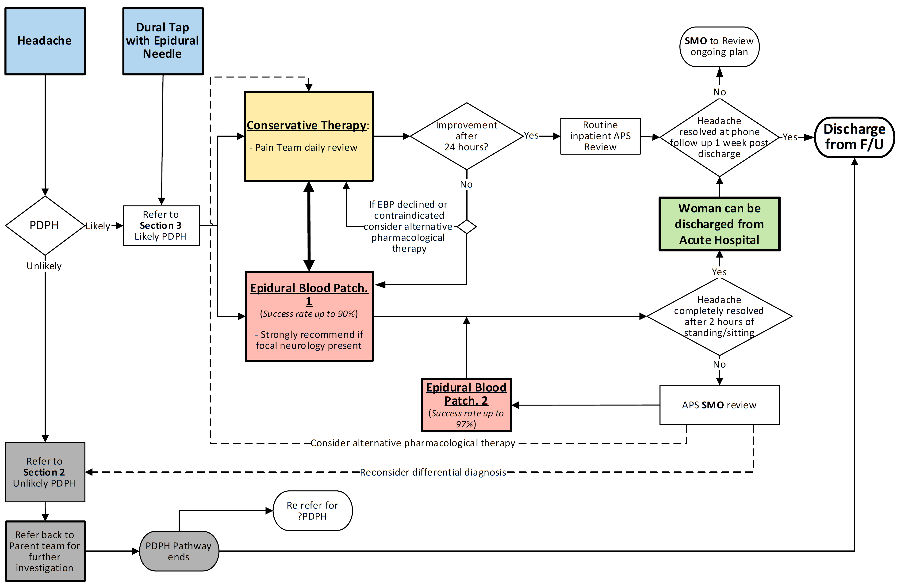
Flow chart
  Promotes appropriate discharge planning
  Uniform approach to management – proceduralist, pain MDT, acute team and LMC
  Ward staff understand our approach and where patient fits into the pathway

Slide 33
PDPH pathway
Easy to follow
Tick boxes
Easy to review/ audit

Slide 34
PDPH pathway
PDPH Unlikely
  Consider Differential Diagnosis
  Prompts to consider
    Neurology opinion
    Further imaging
  Clear who the lead clinician is this scenario

Slide 35
PDPH pathway
Blood Patch Management
Prompts to consider
  Where EBP should occur – preference is in acute theatre with surgical booking form
  Epidural Blood patch procedure documented in SAFERsleep OR
  Mum: Sepsis, anticoagulation status, baby fed?
Clear post procedure plan

Slide 36
PDPH pathway
Discharge
Clear plan for woman and follow up team
Considers Non – Pharmacological
Safeguards in place

Slide 37
PDPH pathway
Alternatives to EBP
Pathway strongly steers user and woman towards EBP
Gabapentin
  400mg load, 200mg TDS
  Pain follow up to titrate up
  …and to wean off

Slide 38
PDPH pathway
New communication with GPs

Slide 39
PDPH pathway

Slide 40
PDPH pathway
Pain Service Follow up
Phone assessment 24hrs & 7days
Any issues discussed with SMO Coordinator
Discharged from follow up and notes scanned

Slide 41
PDPH pathway
My thoughts
Not perfect
Very wordy
Still a paper document, although scanned as PDF
If discharged from follow up – paperwork in to be scanned pile for weeks
Comprehensive – everything in once package
Will be great audit tool – watch this space
Great integration with SAFERsleep maternity.

Slide 42
Placenta Accreta Spectrum MDT

Slide 43
Placenta Accreta Spectrum MDT
Few health conditions are as complex, resource-intensive, and potentially deadly as placenta accreta spectrum disorders (PAS)
PAS is now the most common reason for peripartum hysterectomy
Surgical management of PAS can result in abrupt, unexpected:
  life-threatening haemorrhage
  Dilutional coagulopathy
  Transfusion-related complications
  Cardiorespiratory overload
  Electrolyte abnormalities
  Acute kidney injury
  Intensive care unit admission
  Surgery is frequently complicated by injury to the bladder, bowel, or ureters.
Maternal outcomes are improved when patients with PAS are managed by multidisciplinary teams (MDTs) in experienced referral centers

Slide 44
Placenta Accreta Spectrum MDT
Population-based study of all PAS cases in Utah from 1996 to 2008 - Women with PAS managed with MDT care had a significantly lower:
  Frequency of early maternal morbidity
  Shorter hospital admission
  Reduced stay in ICU
  Reduced volume transfused
  Less coagulopathy
  Less ureteral injury
  Less early reoperation compared to women managed by standard obstetric care
Even at tertiary referral centers, care of women with PAS can be improved by implementing an MDT approach:
  90 cases PAS managed before and after
  Women cared for by MDTs had lower median blood loss (2.1 l vs 3 l, P = 0.025) and less likely to require emergent surgery (23% vs 64%; P = 0.001).

Slide 45
Placenta Accreta Spectrum MDT
Experience and stability of the MDT also matter:
  Single-site study 2011-2016, Shamshirsaz and colleagues evaluated outcomes of patients with PAS over time after establishing a MDT care model. Managed a total of 118 total cases - compared two time periods, early and late (pre April and post April 2014)
  Median blood loss, transfusion, crystalloid transfusion were less common in the latter group, suggesting team learning and experience improved patient safety outcomes over time.
  Impressively, massive transfusion was one fifth as frequent in the latter time period (5.1% vs 25.4%, P < 0.01)
The central role of experienced MDTs in the management of PAS is reinforced by recent international guidelines.
  ACOG- Obstetric Care Consensus, states that the “optimal management of PAS involves a standardized approach with comprehensive MDT accustomed to management of placenta accreta spectrum.”
  RCOG-Green Top Guideline states that “women diagnosed with PAS should be cared for by a MDT in a specialist center with expertise in diagnosing and managing invasive placentation.”

Slide 46
Placenta Accreta Spectrum MDT
2021 Formalised our approach
New PAS referral form – Emailed Placentaaccrete@adhb.govt.nz (Obstetric Chief Resident)
PAS MDT – presents during complex gynaecology MDT
Team =
  Gynaecologist with interest in PAS
  GynaeOncologist
  Radiologist with interest in abnormal placentation
  Anaesthesia - perioperative fellow
  LMC
  Charge Midwife
  Theatre Manager
  Charge Technician
  + As required – Vascular/Urology/General surgeons/Interventional Radiology/ haematologist/ MFM/ Neonatology/ Social worker
Management plan completed including emergency presentation
So far ~20 cases reviewed

Slide 47
Placenta Accreta Spectrum MDT
Who is referred:
  Women with features of, or confirmed diagnosis of PAS
  Ideally by 32 - 34 weeks or as soon as possible upon diagnosis.
  The PreOperative Antepartum Plan (section B of CR4127) completed by the Chairperson of the MDM.
  A copy of the completed form ‘High Risk folder’
  The referrer and LMC will be updated with the result of the MDM.
Birth is generally considered between 34 - 36 weeks, extension up to 37 weeks recommended for uncomplicated women with no history of antepartum haemorrhage.

Slide 48
Placenta Accreta Spectrum MDT

Slide 49
Placenta Accreta Spectrum MDT
Anaesthetic Management Section
Tick boxes – usually select all!
Allows for appropriate theatre time and staffing allocation
Technician team to prep theatre in advance
Usually two technicians per case
Considers Support person
Plan for out of hours team

Slide 50
Placenta Accreta Spectrum MDT
Summary
Diagnosis and treatment of people with PAS are complex, resource-intensive, and pose high risk of maternal morbidity and mortality.
Recent evidence suggests that stable, experienced MDTs focused on continuous systems improvement at high-volume tertiary care centers are superior to standard obstetric management for patients with PAS.
The MDT and PAS guideline promotes and facilitate standardisation and consistency of practice using an MDTapproach.
Ensures all women at risk of Placenta Praevia / PAS are screened, diagnosed and have management plans developed to reduce their morbidity and mortality.
It is ideal to identify patients at risk of morbid placental adherence in advance, so that a timely and planned birth can occur to minimise adverse maternal and neonatal outcomes.
Audit results at next OASIS?

Slide 51
Women’s Health Emergency Manual

Slide 52
Women’s Health Emergency Manual
Current version reviewed in 2015 (Sticker over 2013)
(not much has changed!!)
New topics/ Updates:
  Acknowledgement that emergency perimortem delivery can be perimortem section or by assisted vaginal delivery
  AFE management
  Intrauterine resuscitation
  Cord prolapse
  Placental abruption
  Uterine inversion
Successes with – eclampsia case
Issues

Slide 53
Women’s Health Emergency Manual
Wellington

Slide 54
Women’s Health Emergency Manual
Stanford, California

Slide 55
Women’s Health Emergency Manual
Presentation of information
  Landscape vs portrait
  Use of colour/ font/ bold/underlined/ boxed information/ bullet points vs numbers
  Who is the user – part 2 revision, junior midwife, locum
  List vs flow chart vs pictograms vs prose
  Depth of information covered
  Order of emergencies covered

Slide 64
Women’s Health Emergency Manual
No evidence on how to best present this information
Resembles international and national documents
Does not match emergency manual format in other areas of Auckland
Tailored to Women’s Health & understandable by all users
Goes beyond the first 5minutes of a crisis so you don’t need to google
Hopefully this will have enough longevity that in 2027 someone just stick a new review date sticker over it?

Slide 65
End of List Debrief

Slide 66

Notes:
End of day / end of list debrief
Any one can run it.
Whole team present.
Attempt at being positive throughout.
After set up data was collected on its use

Slide 67
End of List Debrief
Plus
Everyone communicated very well
Anaesthetic SMO taking initiative to call patients family and update as case was more than 6 hrs
Cancelling the second case early so she can eat
Worked well together as a team
Good music

Slide 68
End of List Debrief
Deltas
Scrubbed team unable to use bathroom or eat (case was 8:30-15:40!)
Change of surgeon was not translated onto the booking form
Supposed to be under a different consultant; henceforth, pre-planning was made following the booked surgeon's preference
Swabs should not be thrown on the floor!
Try and not overbook the list in the future please

Slide 69
End of List Debrief
Actions
Nurse in charge to evaluate skill mix in theatre to support surgeons
Send equipment for repair
Change surgeon preference book
Laparoscopic tower fault escalated.
Up and go's for the scrub teams,
? A system where someone triggers and calls the family if the case is running very long and an update, relieve the anxiousness of the family and keep them informed? Could be anaesthesia? With second antibiotic that could be the trigger to call/update the family
DATIX completed

Slide 70
End of List Debrief
Helpful! Makes sure we're all on the same page.
Will need convincing for some other surgical teams.
Great idea. Lovely opportunity for everyone to convey their thanks and end the day in good spirits.
Great project, good for team building!
The general surgeons were not pleased that this was part of the theatre day.
They would rather not do it.
Felt it was extra not needed paper work.
Everyone else thought it was useful.
Project should be standard.
Keep it going
Love it!
Notes:
Summary points on the project

Slide 71
OASIS 2026: What will be new?
Sustainability update – Soft plastic recycling, reduction in plastic use in OR, move towards paperless systems, Syringe Recycling program update
Sip Till Send
Re-Orientation of the maternity theatres to be more woman:baby focused
ERAS+ for Major open GynaeOncology cases
Pre-Habilitation improvement – Physiotherapy – incentive spirometry
PDPH audit
Placenta Accreta Spectrum audit
Enhanced Recovery Program (97P)
Brachytherapy Bunker Program

Slide 72
Summary
QI Projects
Successfully integrated, bespoke digital anaesthetic record keeping system for the delivery suite which maybe coming to a hospital near you
Benefits of a PDPH Pathway
Formalised Placenta Accreta Spectrum MDT
Updated Women’s Health Emergency Manual
End of List Debrief is here to stay

Slide 73
Thank you
See you in 2026!

